Slide 1
Simulations and Cosmic Ray Muon Tomography
Reconstruction with Resistive Plate Chambers

Slide 2
Work Done
Assembly of Resistive Plate Chamber.
Data analysis of data collected from experimental setup.
Preliminary track reconstruction using two RPCs.
Geant4 Simulation of Cosmic rays muon tomography setup
Performing the Simulation on different material to understand how scattering varies with Atomic Number (Z)
Study the various existing reconstruction algorithm.
Implementation of very preliminary version of Point of Closest Approach (PoCA) algorithm.
Reconstruction using PoCA from Simulated data.
24 May 2018 2

Slide 3
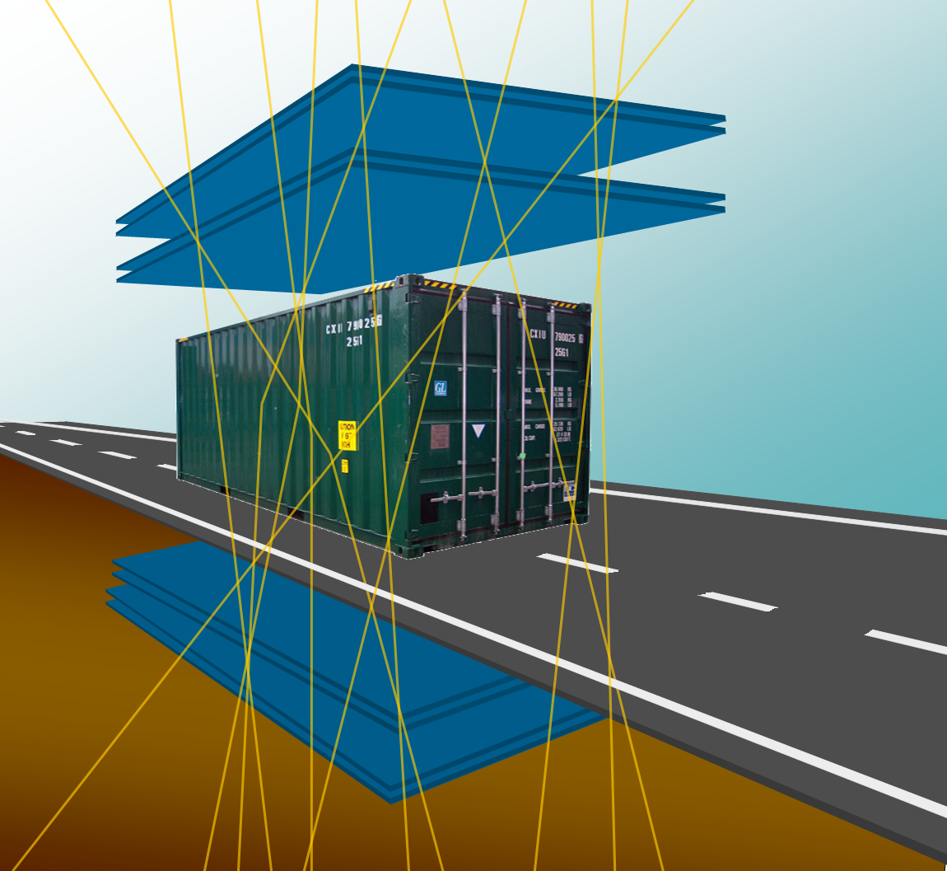
Presentation Overview
Cosmic-rays and muon tomography
Simulation of Muon Tomography using Geant4
Hodoscope Setup at RPC lab
Construction of Muon Detectors
Reconstruction algorithms
Current Status of Project
Conclusion and outlook
24 May 2018 3

Slide 4
FROM RADIOGRAPHY TO TOMOGRAPHY
• Radiography
Projection on a plane defined by a given direction
Typical for single source xray
• Tomography
Reconstruct the 3d distribution of the sample by “cutting” it by planes
With different angle
Need multi directional source
24 May 2018 4

Slide 5
Three different methods of Muon Tomography with cosmic muons
1) Measure Energy Loss before/after the target :
detectors are expensive & have limited energy resolution
2) Measure the attenuation
suitable only for thick/large sized objects
hidden chambers in pyramids (too large)
depth of rocks above an underground tunnel
3) Measure the Scattering angle :
suitable for relatively thin/small sized objects
cargos, trucks etc.
24 May 2018 5

Slide 6
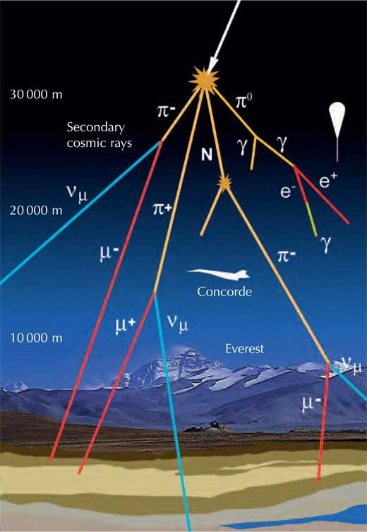
Why Muon Tomography
Secondary cosmic muons: highly penetrating radiations
(even more than X-rays)
Average energy : 3 to 4 GeV
Flux : approximately 10,000 muons per minute per square meter
(Free of Cost) “Natural” radiation, hence no additional dose delivered to users and goods
Muonic interactions well understood
Muon scattering strongly dependent on the Z of the material
Each muon may contribute to determine the overall imaging
24 May 2018 6

Slide 7
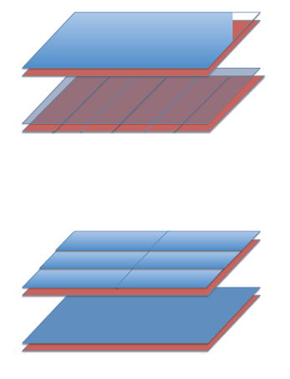
Muon Tomography
a
● Muon tomograph: basically made by several detection planes, above and below the volume to be inspected
● Reconstruction of muon tracks allows to discriminate one material from another, and to identify them
Using some good image reconstruction algorithm one can even
produce a 3D image as well
● Performance of the system are given in terms of
- Sensitive area / volume to be inspected
- Spatial and angular resolution
- Time to scan a volume
- Sensitivity & Efficiency to high-Z objects
- Discrimination between high-Z vs low & medium-Z
High-Z
b
θ
24 May 2018 7

Slide 8
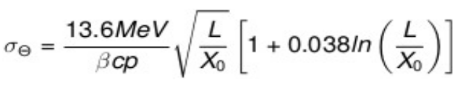
Multiple Scattering : The physics behind muon tomography
Muons, being leptons, interact with matter through the Coulomb force.
The muon passing through the material is deflected by many small angles, scatters off the nuclei of the material
The angular scattering distribution is approximately Gaussian (with long tails), but the central 98% is well described by gaussian with zero mean and standard deviation is given by
24 May 2018 8

Slide 9
Geant4 Simulation
The physics process under study is Multiple scattering
Physics list used FTFP_BERT
Size of Detector 1m X 1m
Number of Detectors : 4
Muon Energy chosen : 2 GeV (ie. Monoenergetic muon)
Scatterer used : Al, Fe, Pb (4 cm, 5cm, 10 cm, 12 cm , 15 cm)
Shape of Scatterer : Cube
In the first stage simulation are done with following assumption :
1) Detectors are 100% efficient.
2) And give the exact hit point.
These assumption are taken to work parallely on Reconstruction algorithm.
In the next stage we will try to remove these assumption, so that we can get simulated data which is more closer to reality.
24 May 2018 9

Slide 10
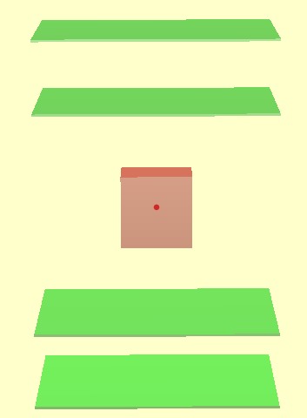
Simulation with different scatterers (Pb , Fe and Al ) cube of varying sizes
( 10cm, 15cm, 20cm... )
RPC-1
RPC-2
Scatterer
RPC-3
RPC-4
24 May 2018 10

Slide 11
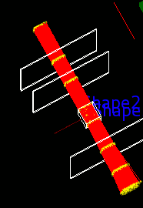
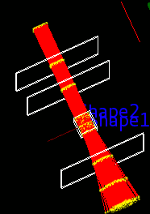
Scattering difference with Iron and Lead Cube of 20 cm
Iron Cube of 20 cm
Lead Cube of 20 cm
24 May 2018 11

Slide 12
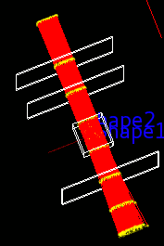
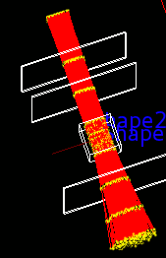
Scattering difference with Iron and Lead Cube of 30 cm
Iron Cube of 30 cm
Lead Cube of 30 cm
24 May 2018 12

Slide 13
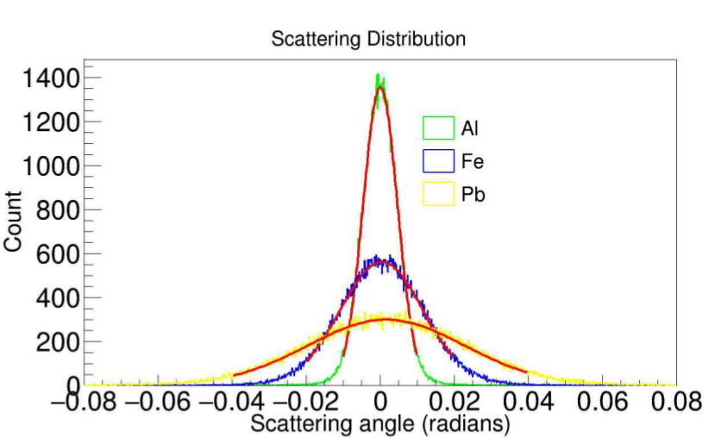
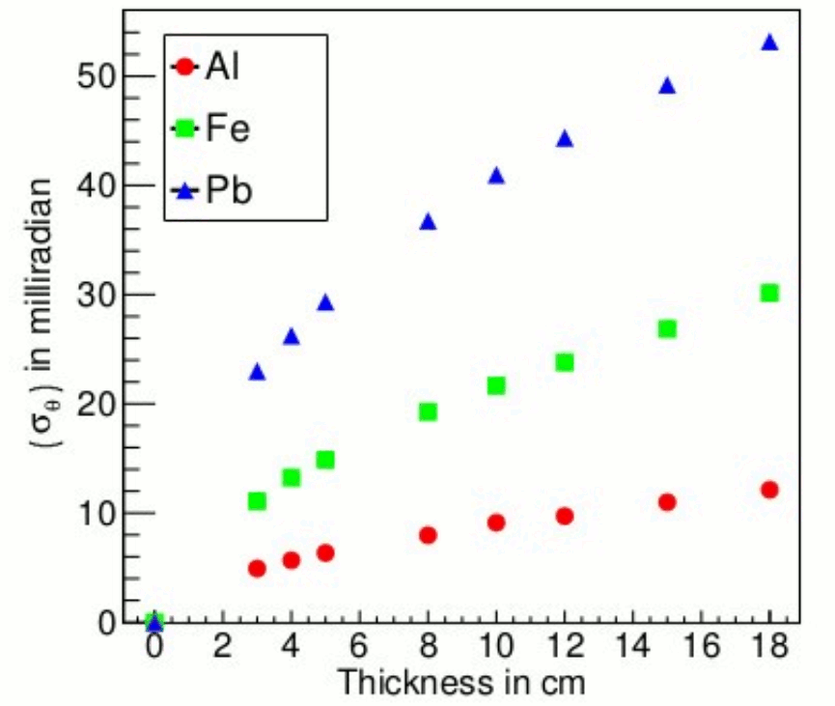
Material Discrimination and Identification
As a first step materials can be discriminated by calculating the standard deviation of the measurement of scattering of N muons passing through the object.
This can tell that one material is having more Z relative to other.
Proceedings of DAE Symposium on Nuclear Physics (Vol. 61, 2016)
24 May 2018 13

Slide 14
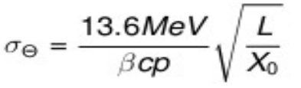
Material Discrimination and Identification Cont..
But cannot tell what actually is the material !!
It may happen that two material of different thicknesses may give same scattering angle
distribution.
To detect the correct material one has to estimate some material property.
We have chosen the Radiation Length
We have worked with three materials Al, Fe and Pb in our simulations.
To make our calculation easier we are using simplified form of previously mentioned formula
As per the literature the radiation lengths of the materialsused in simulations are as follows :Al : 8.897 cms, Fe :1.757 cms, Pb : 0.5612 cms.
24 May 2018 14

Slide 15
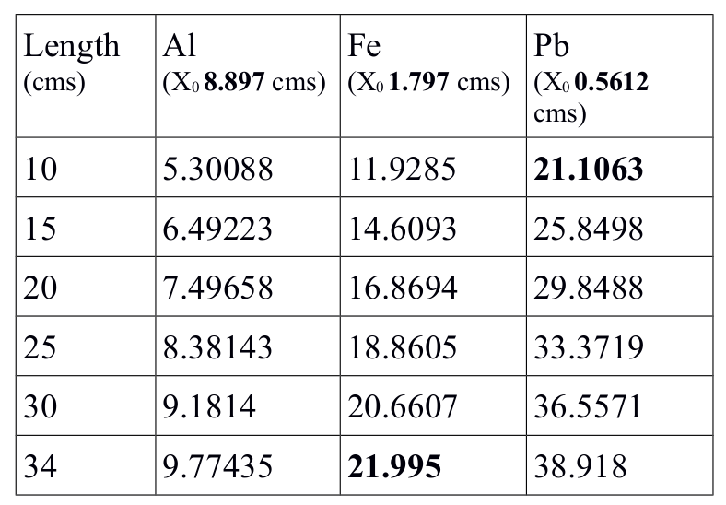
Table specifying standard deviation of scattering angle distribution for different materials of different thicknesses
Proceedings of DAE Symposium on Nuclear Physics (Vol. 62, 2017)
24 May 2018 15

Slide 16
Material Identification using Radiation Length
Here we have considered only one material of known thickness at a time.
In the first case we have taken Fe of 34 cm thickness.
The standard deviation of scattering angle that we get from simulations is around 22.36 mrad
In the second case we have taken Pb of 10 cm thickness.
The standard deviation of scattering angle that we get from simulations is around 21.217 mrad
Using formula 2 we have calculated theradiation length X_{0 i} in both the cases.
The values of radiation length for Fe comes out to be 1.7001 cms
And for Pb it comes out to be 0.5553 cms
Both these values matches closely with the theoretical values
24 May 2018 16

Slide 17
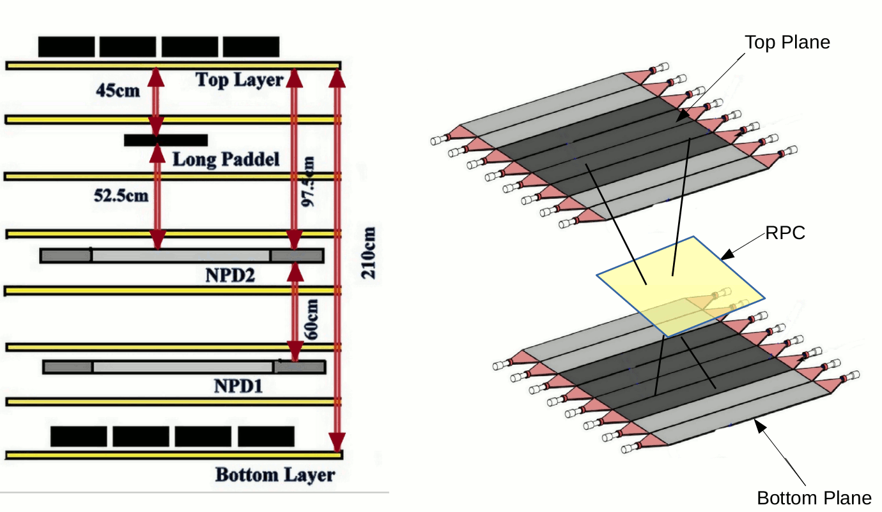
Schematic of setting the muon trigger with scintillator paddles in the hodoscope
24 May 2018 17

Slide 18
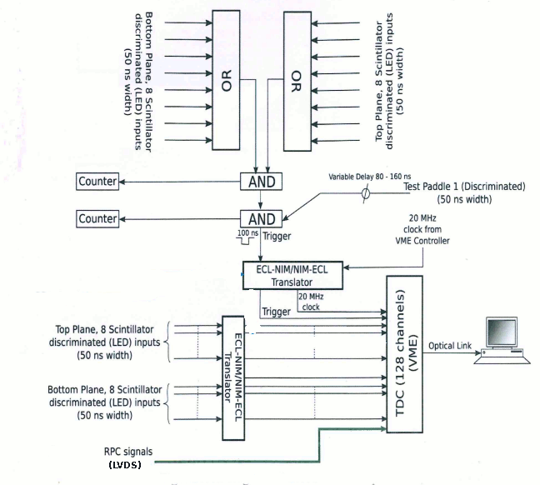
Electronic Setup
24 May 2018 18

Slide 19
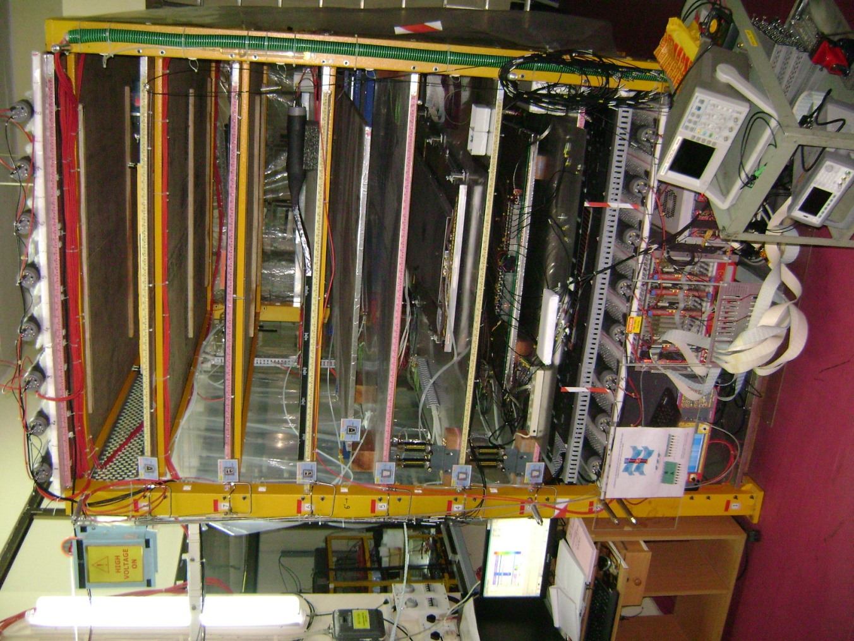
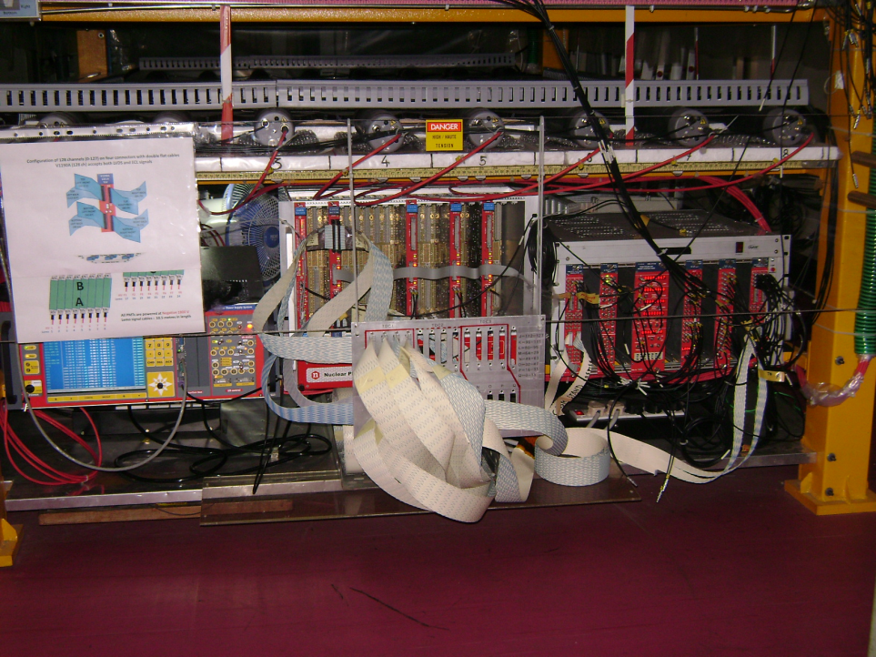
Hodoscope at NPD-BARC
Characterisation of RPCs with Cosmic Muons
Top layer of scintillator paddles
Characterization of CMS RPCs
Muon Tomography (400 ch electronics)
Experiments for TSOs
Project Trainees
VME-DAQ and TDCs (V1190A)
CMS-RPC
Glass-RPC
Bottom layer of scintillator paddles
24 May 2018 19

Slide 20
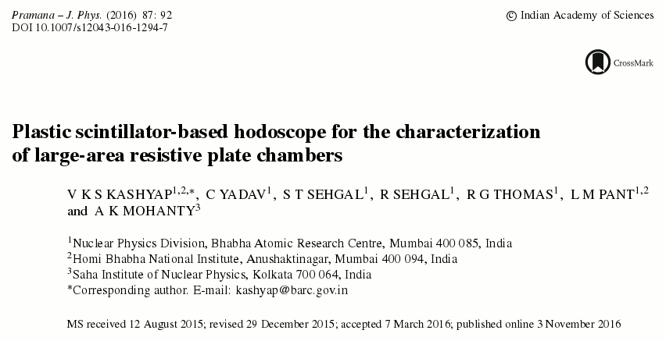
Publication on Hodoscope
24 May 2018 20

Slide 21
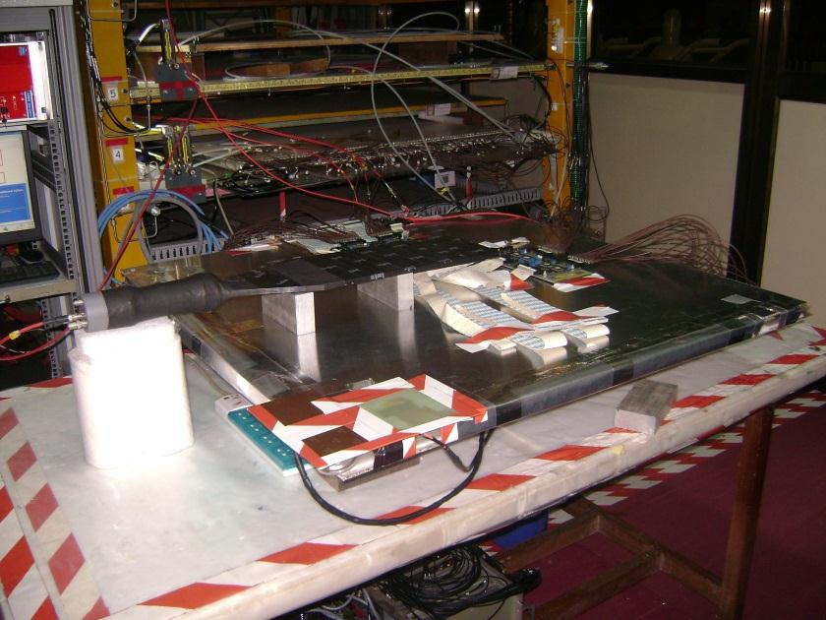
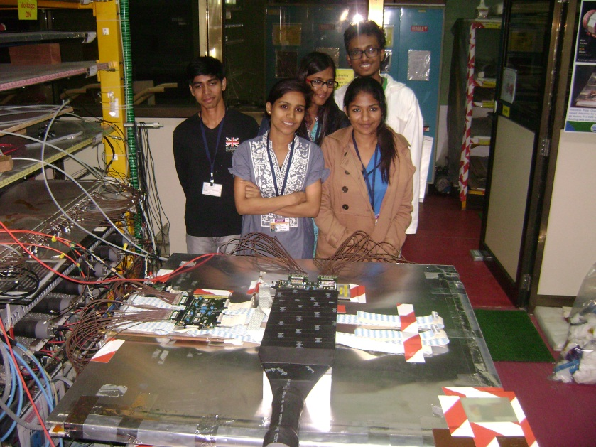
Construction of Muon Detectors
Direction of insertion of RPC in Hodoscope
FEB-A
B1, B2
FEB-B
A1, A2
gas
outlet
Honey Comb Panel
gas
inlet
HV
point
Top Gas Gap
gas
U tube
Bottom Gas Gap
Thermocol
Honey Comb Panel
HV
point
24 May 2018 21

Slide 22
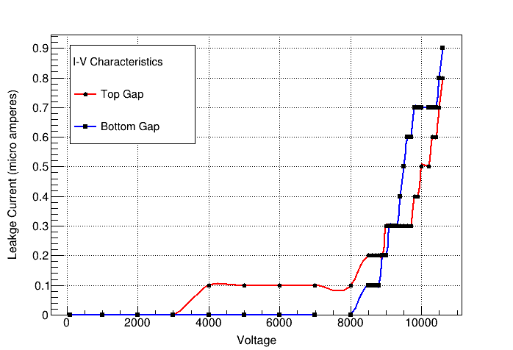
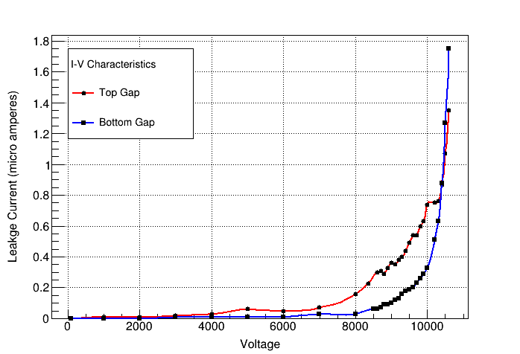
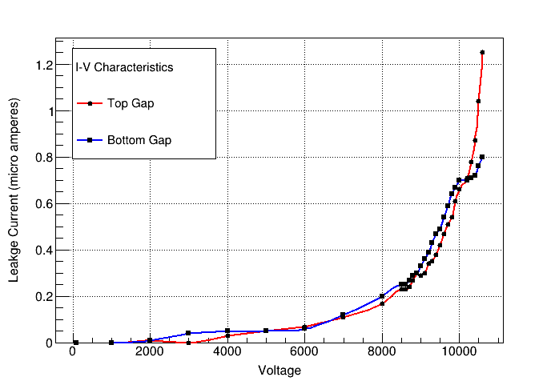
I-V Characteristics of Gaps of RPCs
RPC-1
RPC-2
RPC-3
24 May 2018 22

Slide 23
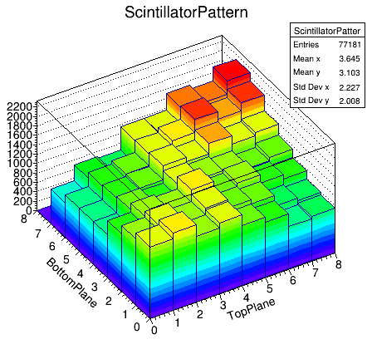
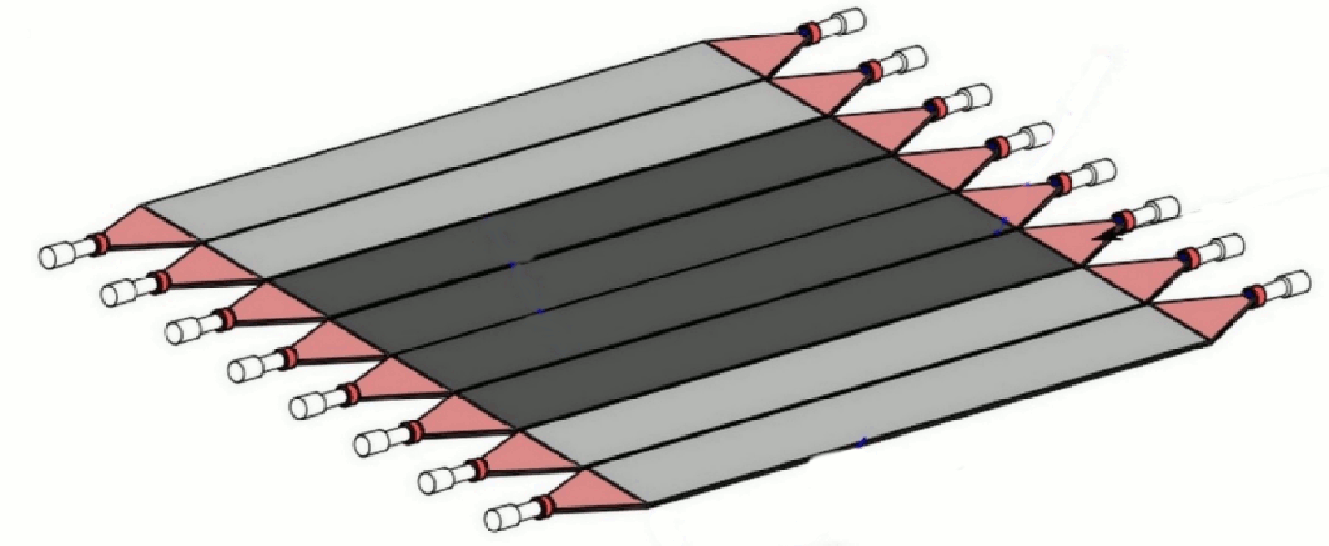
Top and Bottom Scintillator Plane Pattern
Top Plane
Bottom Plane
24 May 2018 23

Slide 24
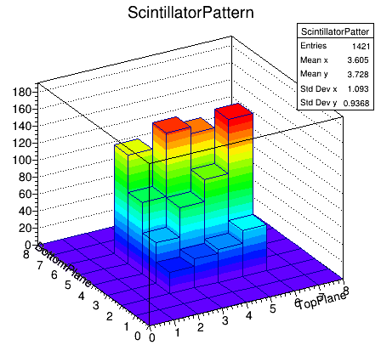
Top and Bottom Scintillator Plane Pattern (only middle four are swtiched ON)
Top Plane
Bottom Plane
24 May 2018 24

Slide 25
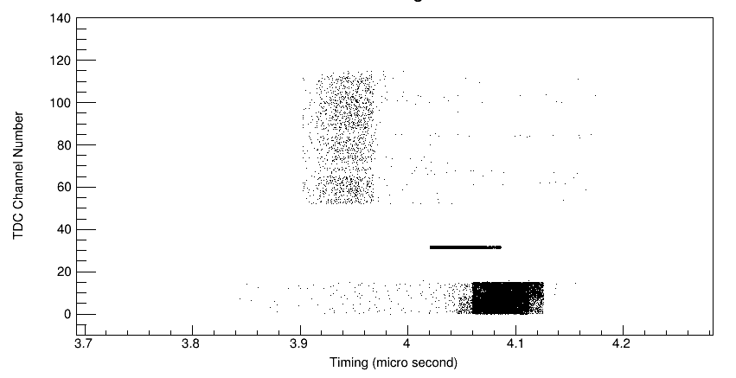
Calibrated Timing Histogram to select the desired window width with respect to Trigger
24 May 2018 25

Slide 26
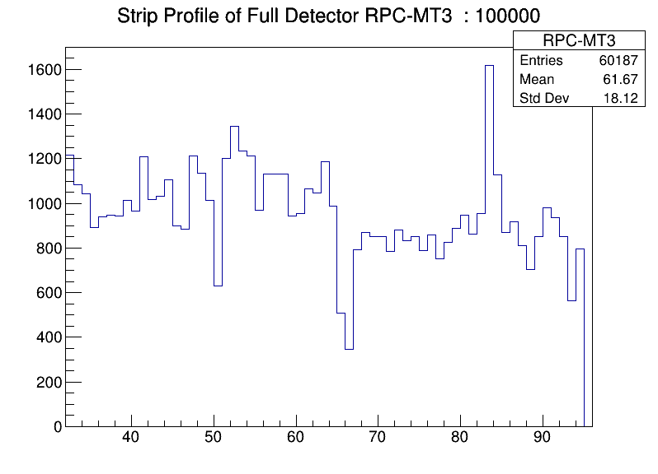
Strip Profile of Full Detector (X and Y plane)
24 May 2018 26

Slide 27
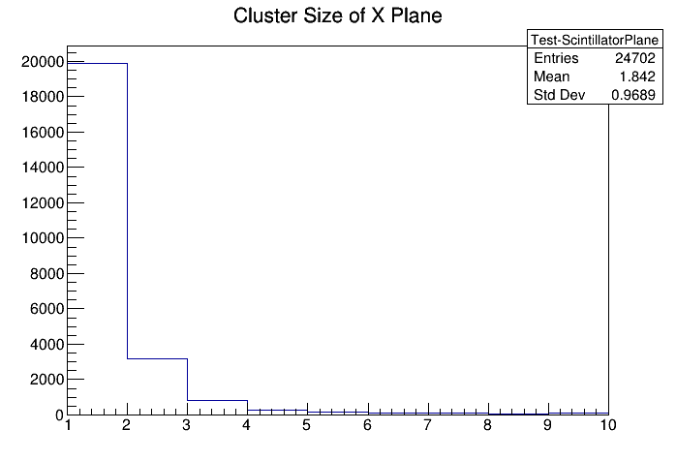
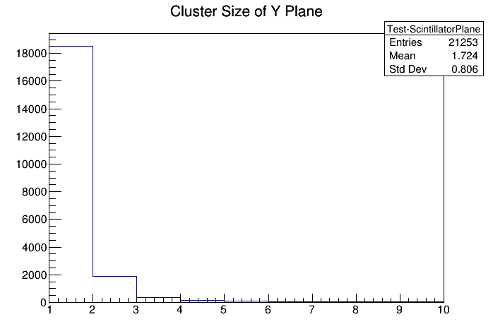
Cluster Size of X and Y Plane Strips
24 May 2018 27

Slide 28
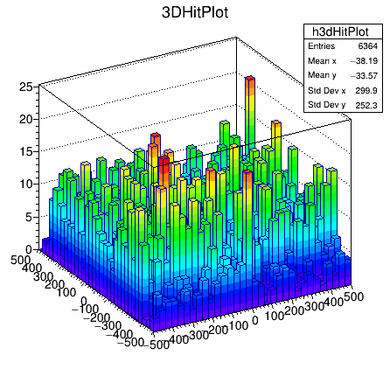
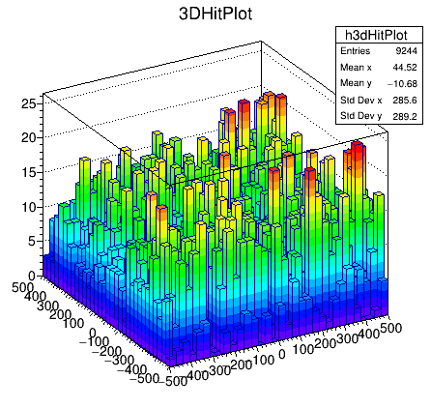
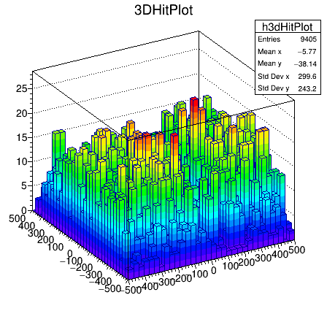
3D Hit plot of RPCs
RPC-1
RPC-2
RPC-3
24 May 2018 28

Slide 29
Track Reconstruction Algorithm
Due to spatial resolution of RPC, we don't get the exact hit location.
What we got is, the strip number that got fired in X and Y Plane.
As a first step we have considered only those events where only one strip fired in X and Y.
Once we get the strip numbers, we try to map them to 3D coordinate system, with origin as the centre of hodoscope.
One strip in X and Y direction give us the area (Pixel) on the Detector from where the muon has pass through.
The area of this pixel is rough 2.8cm X 2.8cm
We took the center of the pixel as the muon hit position (which is not actually true), infact the hit position is distributed throughout the area of the pixel.
The true position can be obtained by fitting the straight line through the center of fired pixel for the stack of 'N' detector.
The more the number of detectors the better is the hit location estimation.
24 May 2018 29

Slide 30
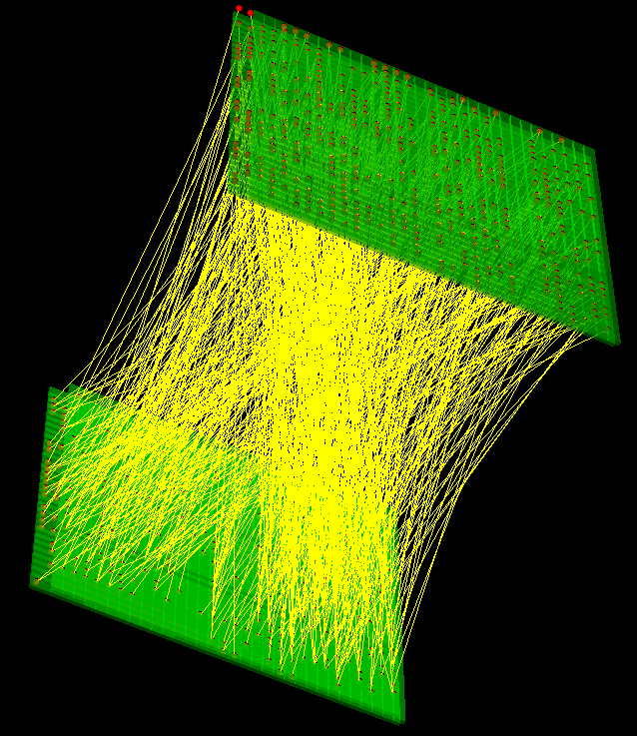
Muon Tracks from two RPCs (1m x 1m) with 32 read outs each in X and Y planes
(From Experimental data)
Here we have tried to visualize the muon tracks from two RPC detectors.
These are separated vertically by 120 cm
Only those events are considered where only one strip fired in X and Y.
The figure display 600 such tracks.
24 May 2018 30

Slide 31
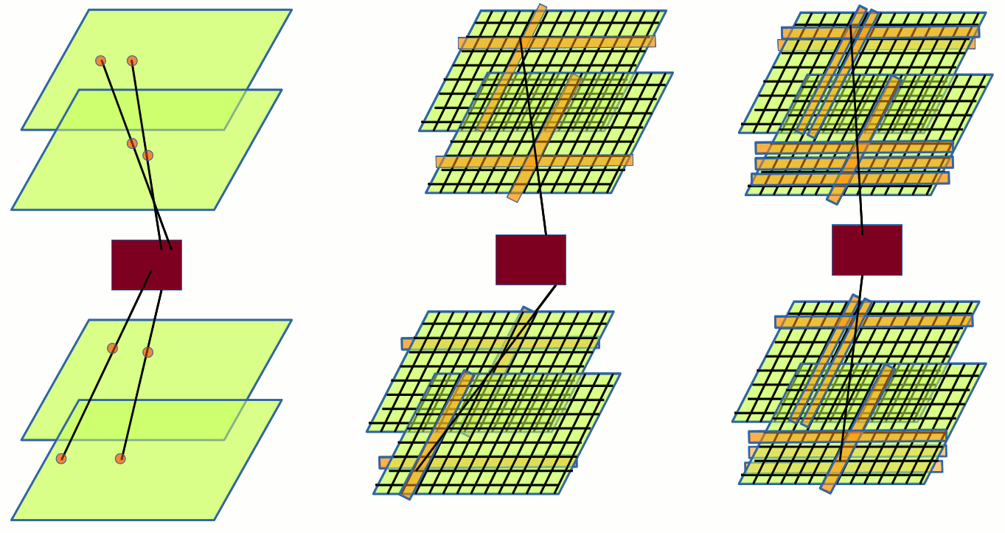
Schematics of various situations
Ideal Situation (Simulations)
Currently what we are doing
In Reality what may be happening
24 May 2018 32

Slide 32
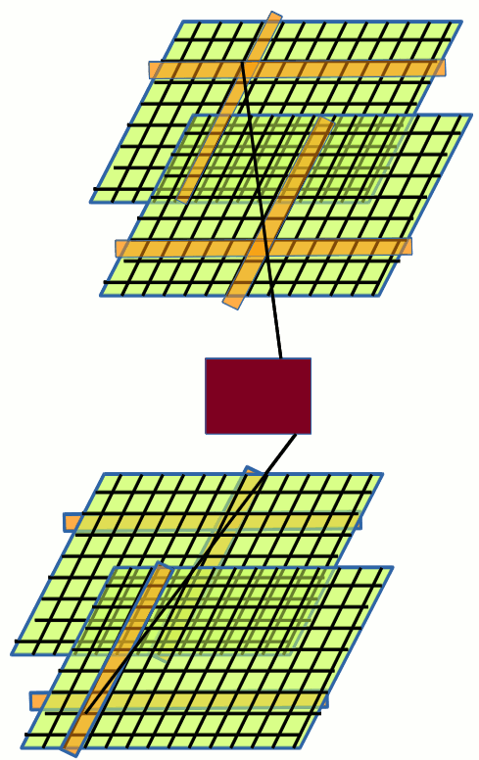
Limitations
Currently the main limitation is the number of detectors.
In order to reconstruct the track, we are chosing only
those events, where only one strip fired in X and Y plane.
This will result in reduced detector efficiency.
In addition to that, the event will be useful only if all the detectors fired with above mentioned criteria.
This will result in reduced overall tracking efficiency.
How to overcome these limitations.
Increase the number of detectors
So that we can also take those events where multiple strips fires in X and Y planes.
With this we get more detector efficiency.
Take the line of best fit as the muon track.
24 May 2018 33

Slide 33
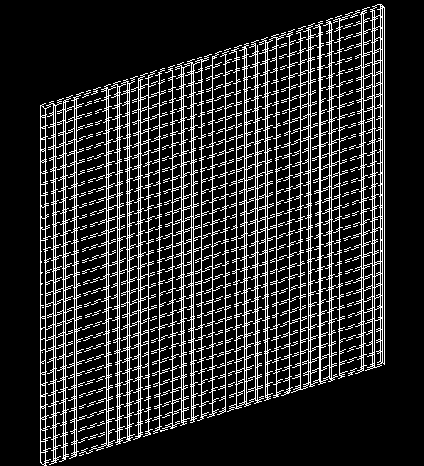
Next stage Simulation Plan
Start with setup consist of 4 Resistive
Plate Chambers (RPC) placed in Z direction.
Each RPC of 1m x 1m surface area will be having two readout planes (X and Y) and will be placed orthogonally.
Each of these planes will be having 32 readout strips.
The strips will be separated by 2mm dead area.
Instead of storing the exact hit point, we will store the hitted strip number in X and Y plane.
This will exactly mimic the geometry of real RPC.
Then we will run these simulation with different numbers of detector each time, and get the line of best
for incoming and outgoing trajectory
This will give the idea of minimal number of detectors required to get the hit position closer to exact hit point
24 May 2018 34

Slide 34
Image Reconstruction Algorithms
Point of Closest Approach (POCA)
Purely geometry based
Estimates where each muon is scattered
Maximum Likelihood Expectation Maximization for Muon Tomography
Introduced by Schultz et al. (at LANL)
More physics based-model than POCA
Based on the concept of Voxelization
Estimates Scattering density (λ) per voxel
24 May 2018 35

Slide 35
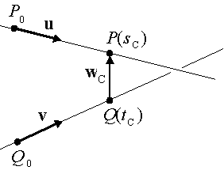
Image Reconstruction using
Point of Closest Approach (POCA) : A purely geometric algorithm
Consider two lines L1 and L2 : Analogous to Muon tracks in our case
Let W be a vector between points on the two lines.
We want to find the d(s,t) that has a minimum length for all s and t.
The distance 'd' is know as distance of closest approach.
The mid point of P and Q is said to be the Point of Closest Approach (POCA)
In muon tomography we assumed this POCA point to be the one where scattering has happened
This algorithm assumed single point scattering but completely ignores multiple scattering which is really happened.
24 May 2018 36

Slide 36
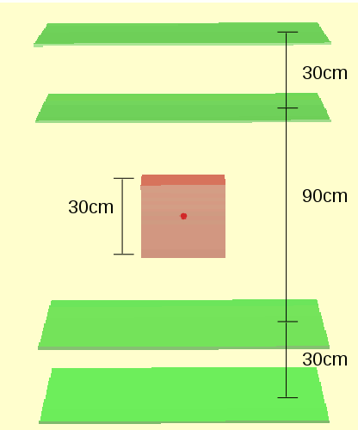
Simulation Setup to test Point of Closest Approach (PoCA) algorithm,
With a Lead Cube of 30 cm as scatterer
Number of Events acquired in Simulation : 20,000
Scatterer : Cube of Lead of 30 cm side
Energy of injected muons : 2GeV
24 May 2018 37

Slide 37
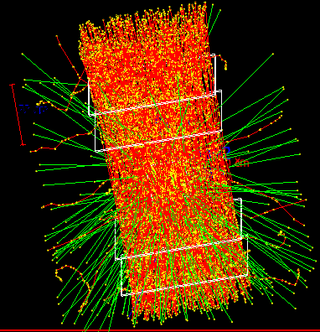
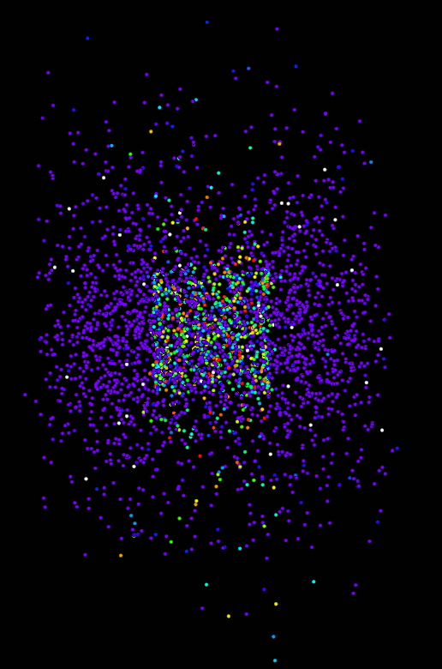
Reconstruction using PoCA point cloud from simulation data
24 May 2018 38

Slide 38
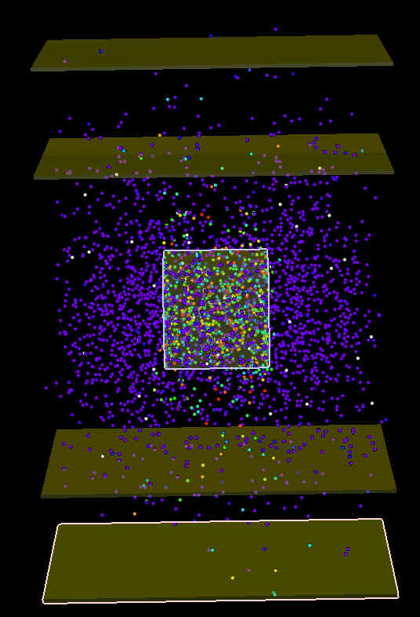
PoCA point cloud superimposed with Simulation Geometry
24 May 2018 38

Slide 39
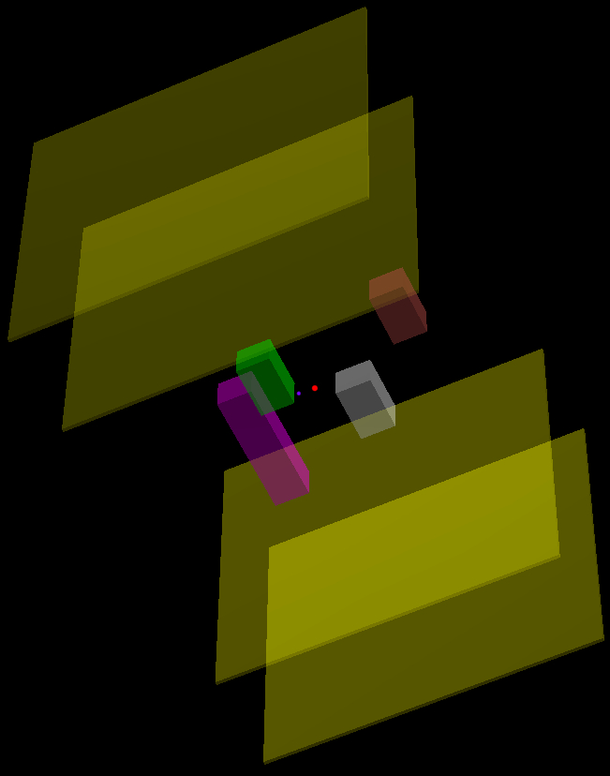
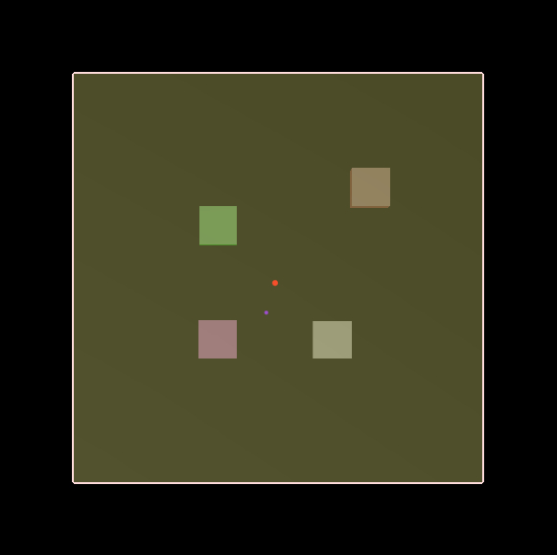
Simulation Setup with four different material
Four material of different dimension of box shape are kept at four different location between a pair of top detectors and a pair of bottom detectors
Fe
U
Al
Pb

Slide 40
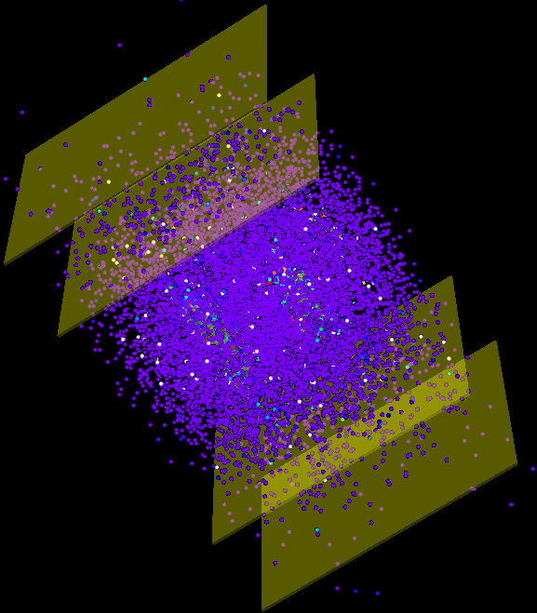
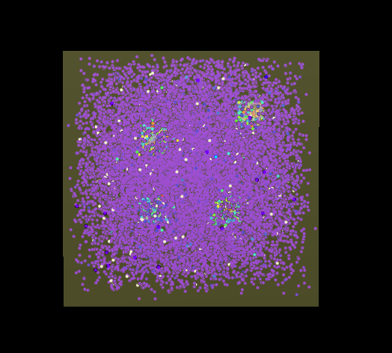
Results from Point of Closest Approach (POCA)
Plotting all the Poca point for which the
calculated scattering angle is less than 0.3 milliradian
A lot of false positive signal
Not suitable for scenario where there are multiple
objects of if the object sizes are big.

Slide 41
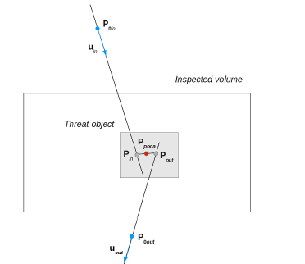
Conclusion from POCA Algorithm
Simplest approach, fast and easy to implement
Geometrical point of closest approach between incoming and outcoming tracks
However:
Neglects multiple scattering within the material
Poor resolution images
Critical behaviour for material located close to volume borders
Several improvements may be implemented:
- Filteration using Voxelization
- Density based clustering algorithms

Slide 42
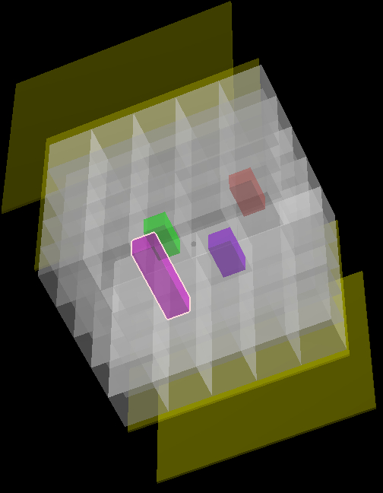
Voxelization of Volume of Interest
Dividing the volume of interest into small boxes
called Voxels
These Voxels can be very much helpful in
removing the false positive POCA points.
If a Voxel belong to some material then the
scattering of Poca points that Voxel contains are
correlated.
If a Voxel contains false Poca Point then those
Poca Points are uncorrelated.
Another simple criteria to detect if the Poca
points that Voxel contains are genuine or not is
the Threshold on the number of Poca Points (N)
that a voxel cantains.
If N < threshold value then the Poca Points are
not genuine and may be rejected
Big Question : How to select the threshold
value ??

Slide 43
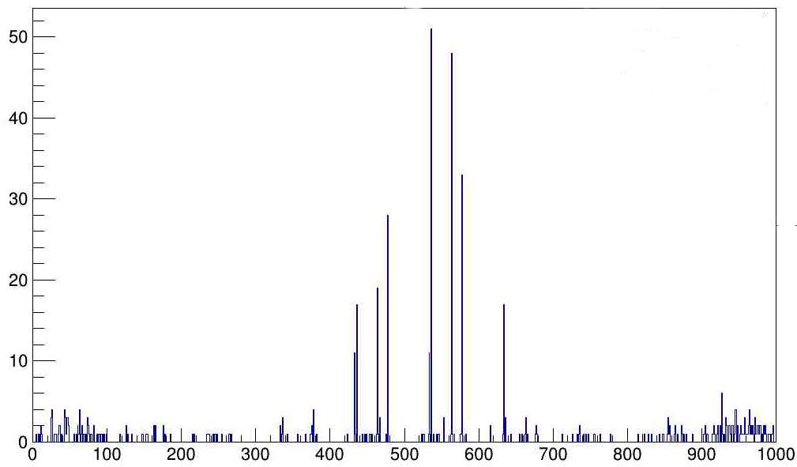
One Dimensional Histogram of counts of POCA points in Voxels
Count
Voxel Number

Slide 44
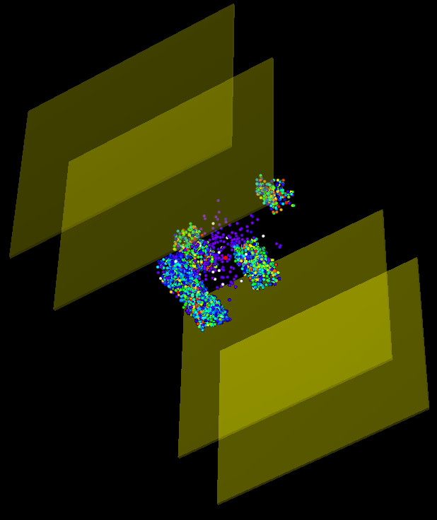

Filteration of POCA output using Voxelization
Output of filteration algorithm applied on POCA
points
Filteration is done by voxelizing the volume
between 2nd and 3rd detector where objects under
test are placed
This removes majority of false positive and the real
objects are clearly visible

Slide 45

POCA Pro's and Con's
Pro’s
Fast and efficient
Accurate for simple scenario’s
Con’s
No Physics: multiple-scattering ignored
Deterministic
Unscattered tracks are not used
10/27/2009
IEEE NSS-MIC 2009, Orlando, FL
<number>
Notes:
<number>

Slide 46
What we achieved !!
Till now we have seen what is POCA
How it works.
What are the drawbacks
The main drawback : Its NOT using the underlying physics, purely geometrical.
But when accompanied with Voxelization and Filteration, it works nicely and give us a
very course reconstructed image.
With this we can only reconstruct very approximate shape, and can only pin point the
location of object under test.
We cannot differentiate between object materials.
But the target of Muon Tomography is to reconstruct the image as well to give some
information about object material.
That is possible when we include underlying physics in the algorithm.
In this case the underlying physics is the Multiple Scattering.

Slide 47


The EM-ML method
Maximum Likelihood Expectation Maximization (MLEM)
Better statistical treatment of scattering processes by a log-likelihood method
Volume to be inspected divided into voxels
Scattering density defined for each voxel
Iterative estimation with some stopping criterion

Slide 48
ML-EM Algorithm
(adapted from Schultz et al., TNS 2007, & Tech Reports LANL)
One Dimensional Histogram of counts of POCA points in Voxels
(1) gather data: (ΔΘ, Δ, p): scattering angles, linear
displacements
(2) estimate track-parameters (L, T) for all muons
(3) initialize λ (arbitrary small non-zero number)
(4) for each iteration k=1 to I (or, until λ stabilizes)
(i) for each muon-track i=1 to M
Compute C_{ij}
(ii)for each voxel j=1 to N
(5) return λ

Slide 49
MLEM Pro's and Con's
Pro's:
Uses underlying physics of process involved
Can give more accurate information about the composition
of object under test.
Con's
Very slow for complex scenarios
Challenges
Reconstruction using MLEM need smart data structures for speed up and better memory usage
Possible options:
Usage of Vector Architecture of CPUs
Using GPUs to do the processing

Slide 50
Overall Status of Project
Hardware
Four Resistive Plate Chamber (RPCs) are already assembled.
Data taking from these RPCs are going on.
Once all the four RPC are tested then minimum hardware setup is ready to give us the incoming and outgoing muon track, and these tracks will be consumed by image reconstruction algorithm.
Software
Completely written in C++.
Depending on ROOT for data analysis.
Visualizer depends on EVE package of ROOT.
Visualization is done using OpenGL.
Track reconstruction from data is done, tested with both simulated and real data
Preliminary PoCA implementation is done.
24 May 2018 40

Slide 51
Conclusion
Muon tomography is very promising technique for the detection of high Z materials.
Simulations are done (using Geant4) to understand the scattering pattern for different material.
Simulated data is used to discriminate the material and to test reconstruction algorithm.
First basic version of PoCA is already implemented, and results are encouraging.
Simulation program will be modified to generate the data much closer to real data.
PoCA output contains a lot of false positive, so we have to work on removal of these false positive.
We will try PoCA reconstruction on the scatterers of different shapes and sizes.
There is a need of some good clustering and filteration algorithm, that can improve PoCA results.
Parallely we had also started the study of MLEM algorithm to reconstruct better image.
We will assemble the fourth RPC very soon.
Then we will try to compare the experimental results with simulated results from simulation setup of 4 RPCs
Outlook
24 May 2018 42

